Slide 1
Laplacian EigenMap
0405 第一次小組討論

Slide 2
Algorithm Card
1. Task? Constructing a representation for data.
2. What kind of algorithm? “A geometrically motivated algorithm”
3. What kind of data?
“data sampled from a low dim manifold embedded in a higher dimensional space”
4. What’ s the tool/key?
Graph Laplacian;Laplace Beltrami operator;Heat Equation
5. What’s the insight?
Take into account the structure of the manifold.
6. What’s the advantage?
Computationally efficient approach to non linear dimensionality reduction; locally preserving properties; natural connection to clustering.

Slide 3
Algorithm
1. Constructing the graph.
A. Epsilon neighborhoods / B. N nearest neighbors
2. Choosing the weights
A. Heat Kernel / B. Simple Minded (Wij = 1 if and only if i and j are connected)
3. Eigen maps
Compute eigen values and eigen vectors for the generalized eigen vector problem,
The image of xi under the embedding into the lower dimensional space is given by (y1(i), ..., ym(i))

Slide 4
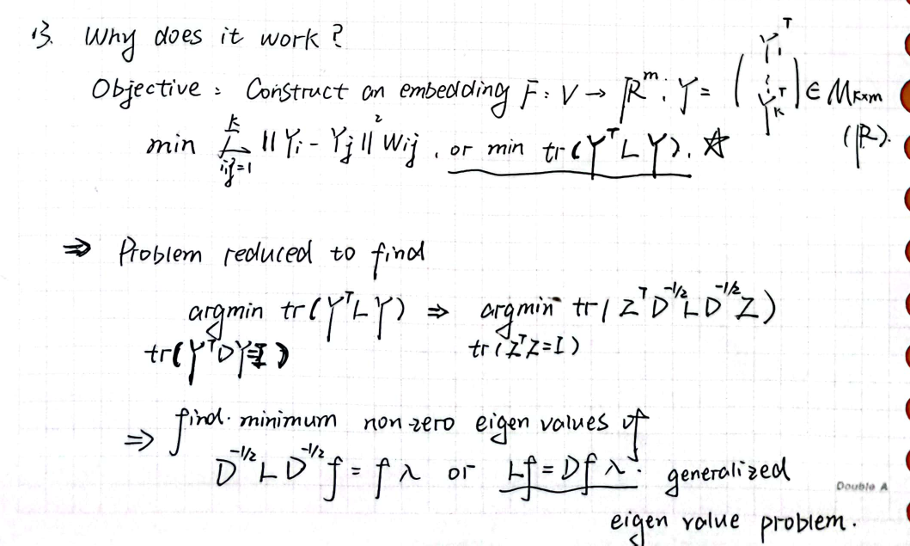
Justification
……

Slide 5
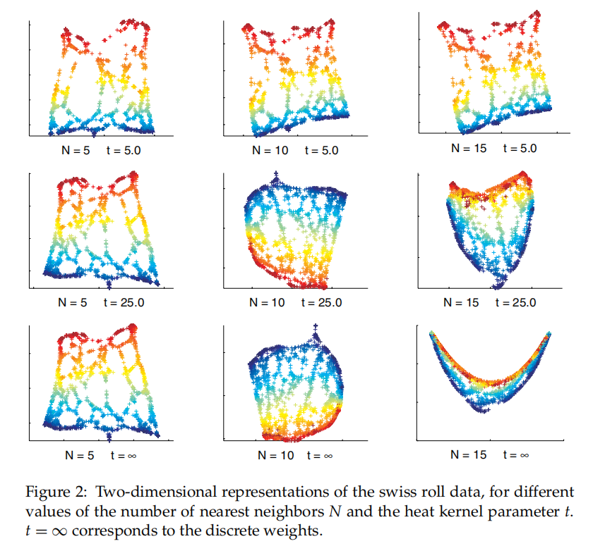
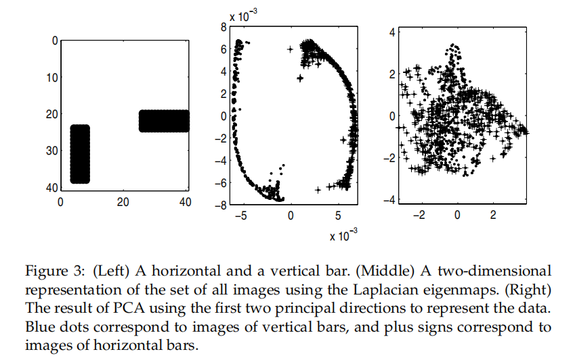
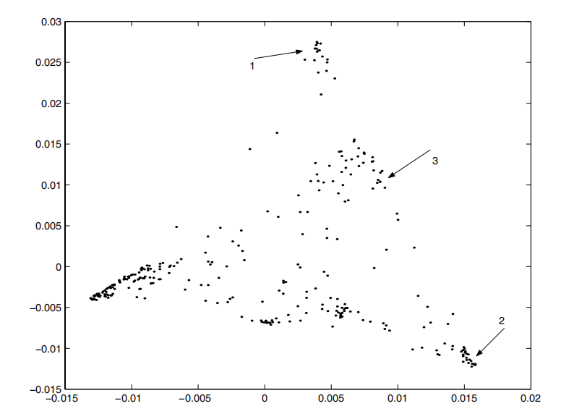
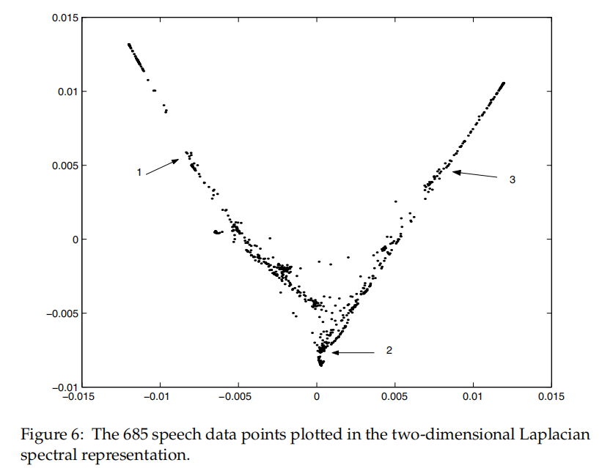
Simple Examples
Swiss Roll
Toy Vision
Word Cluster
Speech Cluster

Slide 6
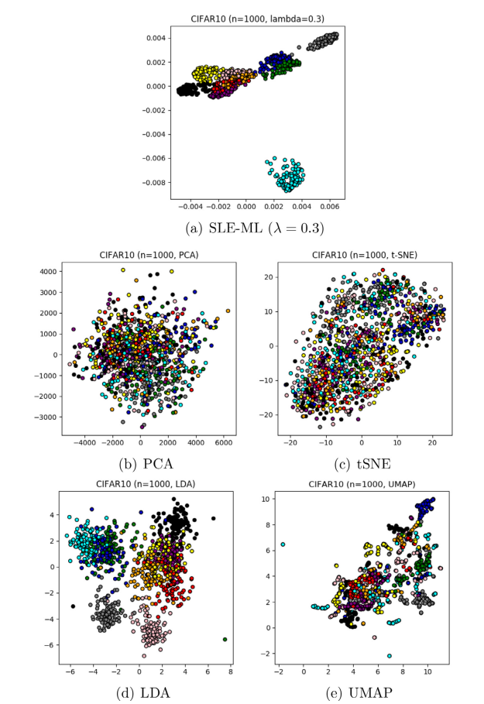
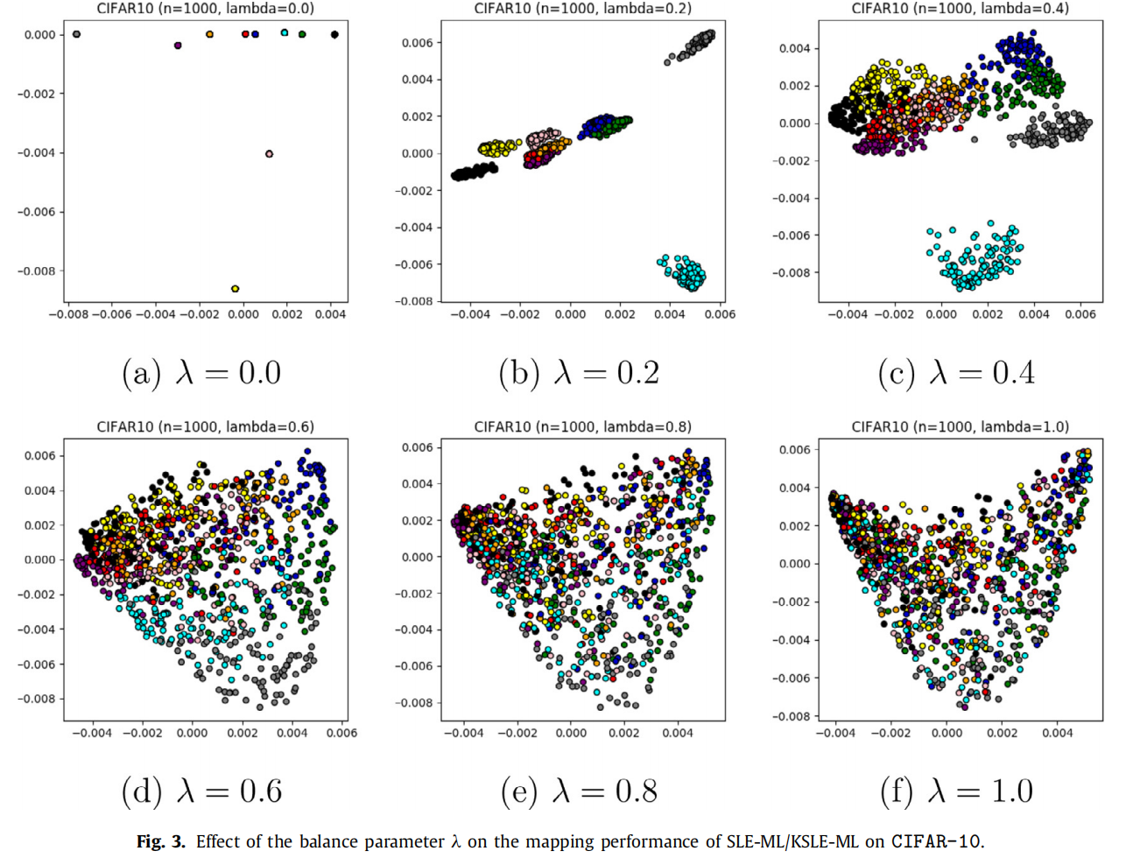
Further Examples
Supervised LEs for Pattern Recognition and Image Clustering

Slide 7
Questions Remained
How to estimate the intrinsic dimensionality is not answered.
Appropriate choices for N and t and their effect on the behavior of the embedddings need to be better understood.
The convergence of the finite sample esitmates of the embedding maps needs to be stressed.

Slide 8
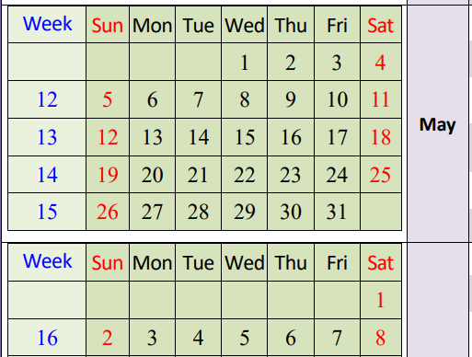
Report Outline
Survey Stage
A. Mathematical Justification
(Comparison? Further investigate?)
B. Realization (Need Coding)
(Supervised LE for further application?)
Weekly meeting to update the progress
1st Deadline 04/28
Wrap up Stage:
Make Slide (Canva)
Presentation (5/14-6/4)
Written Report (6/4) (Overleaf)
1 Introduction
2 The Algorithm
3 Justification
4 Examples
a. Generated data (Toy / Swiss Roll)
b. Real world data (Sound / Words)
c. Further Applications (Image Clustering?)
5 Discussion
(Maybe we can answer the remained questions.)

